Slide 1
Examination Department, BCPS
Topic:
FCPS II Written Script Assessment
Professor Quazi Tarikul Islam
Controller of Examination, BCPS

Slide 2
Introduction: Last 3 years FCPS-II, Preliminary FCPS-II and FCPS (final) written script result assessment was done for the candidates who scored 13 but less than 14-grade. (these students are enrolled for next steps of examination in written result)

Slide 3
Observation:
Less than 2.5% only could succeed in the final exit. More than 70% candidates score between (13-14).
Proposal of exclusion of grade 13 candidates from next step enrollment were discussed in Examination Committee then sent to Executive Committee, BCPS.
Executive Committee assessed the whole matter and send to Council for final decision.

Slide 4
Observation:
It was discussed in the Council and decision was taken that , for a very negligible percentage of students, who score 13-grade in written can cross final exit.
So, the lowest recoverable grade is set at 14 with effect from July, 2013.

Slide 5
Observation:
As you know, there are 3 compartment of FCPS-II, Preliminary FCPS-II and FCPS (final) examinations. Compartments are -
Written
Clinical
Practical
Each compartment require pass grade 15 total (3×15) 45 . A candidate can pass if he secures 43.5 because still we have 1.5 president’s grace mark.

Slide 6
Examples:
Written = 14
Clinical:
Short Case + Long Case = 14
OSPE + Oral = 15.5
43.5 + 1.5=Pass
Written = 15
Clinical:
Short Case + Long Case = 13.5
OSPE + Oral = 15
43.5 + 1.5=Pass

Slide 7
Examples:
Written = 13.5
Clinical:
Short Case + Long Case = 15
OSPE + Oral = 15
43.5 + 1.5=Pass
Written = 13
Clinical:
Short Case + Long Case = 16 / 15
OSPE + Oral = 14.5 / 15.5
43.5 + 1.5=Pass (Very rare <2.5%)

Slide 8
Examples:
Written = 13
Clinical:
Short Case + Long Case = 14/15
OSPE + Oral = 15 / 14
42 / 43 Fail
Written = 14
Clinical:
Short Case + Long Case = 15
OSPE 8+18 = 13
Oral 12+16 = 14
42 / 43 Fail

Slide 9
Examples:
Written = 16.5
Clinical:
Short Case + Long Case = 14
OSPE + Oral = 13
43.5 Pass
Written = 15.5
Clinical:
Short Case + Long Case = 16.5
OSPE + Oral (10+15) = 12.5
44.5 Fail

Slide 10
Examples:
Written = 16
Clinical:
Short Case + Long Case = 12.5
OSPE + Oral = 17
45.5 Fail
Written = 13
Clinical:
Short Case + Long Case = 16
OSPE + Oral = 14.4
43.4 Fail

Slide 11
Your Script (individual):
It may or may not affect the total grade of written result: (Total 104 were enrolled before)
From July 2013, 112 marks (14-grade) will be enrolled for next step of examination.

Slide 12
Guidelines for Assessment of Written Scripts
The Answer scripts are to be assessed in light of standard response scheme constructed by a panel of subject matter specialists (Moderator).
The Examiners are to go through the provided standard response scheme before assessing the scripts.
In case an Examiner considers inclusion/ exclusion of some other essentials/nonessentials not included / excluded originally designed response scheme. If the script assessor may discuss it with the moderators for modification: the change may be introduced with prior endorsement.

Slide 13
Guidelines for Assessment of Written Scripts
Each response to a question is to be assessed component-by-component outlined in the standard response scheme and marks are to be awarded accordingly i.e. component by component.
Marks awarded to each component including ‘zero’ are to be noted on the left-hand margin of the response/non-response with green ink. Total marks awarded to the whole question are to be posted in the provided mark-sheet.
If you are not provided with a standard response scheme (where number of examinees are small). You are expected to construct your own standard response scheme prior to assessing the scripts and submit it to the examination department as a reference.

Slide 14
Guidelines for Assessment of Written Scripts
NOTE : Recoverable border line mark will be 14 grade. Less than 14 grade will be considered as clear fail.
Apology : This change of marking scheme is likely to bring some extra stress and demand on time to the respected examiners.
We expect that familiarity will soon be developed to make the task more reflexive.
Thank you for earnest support.

Slide 15
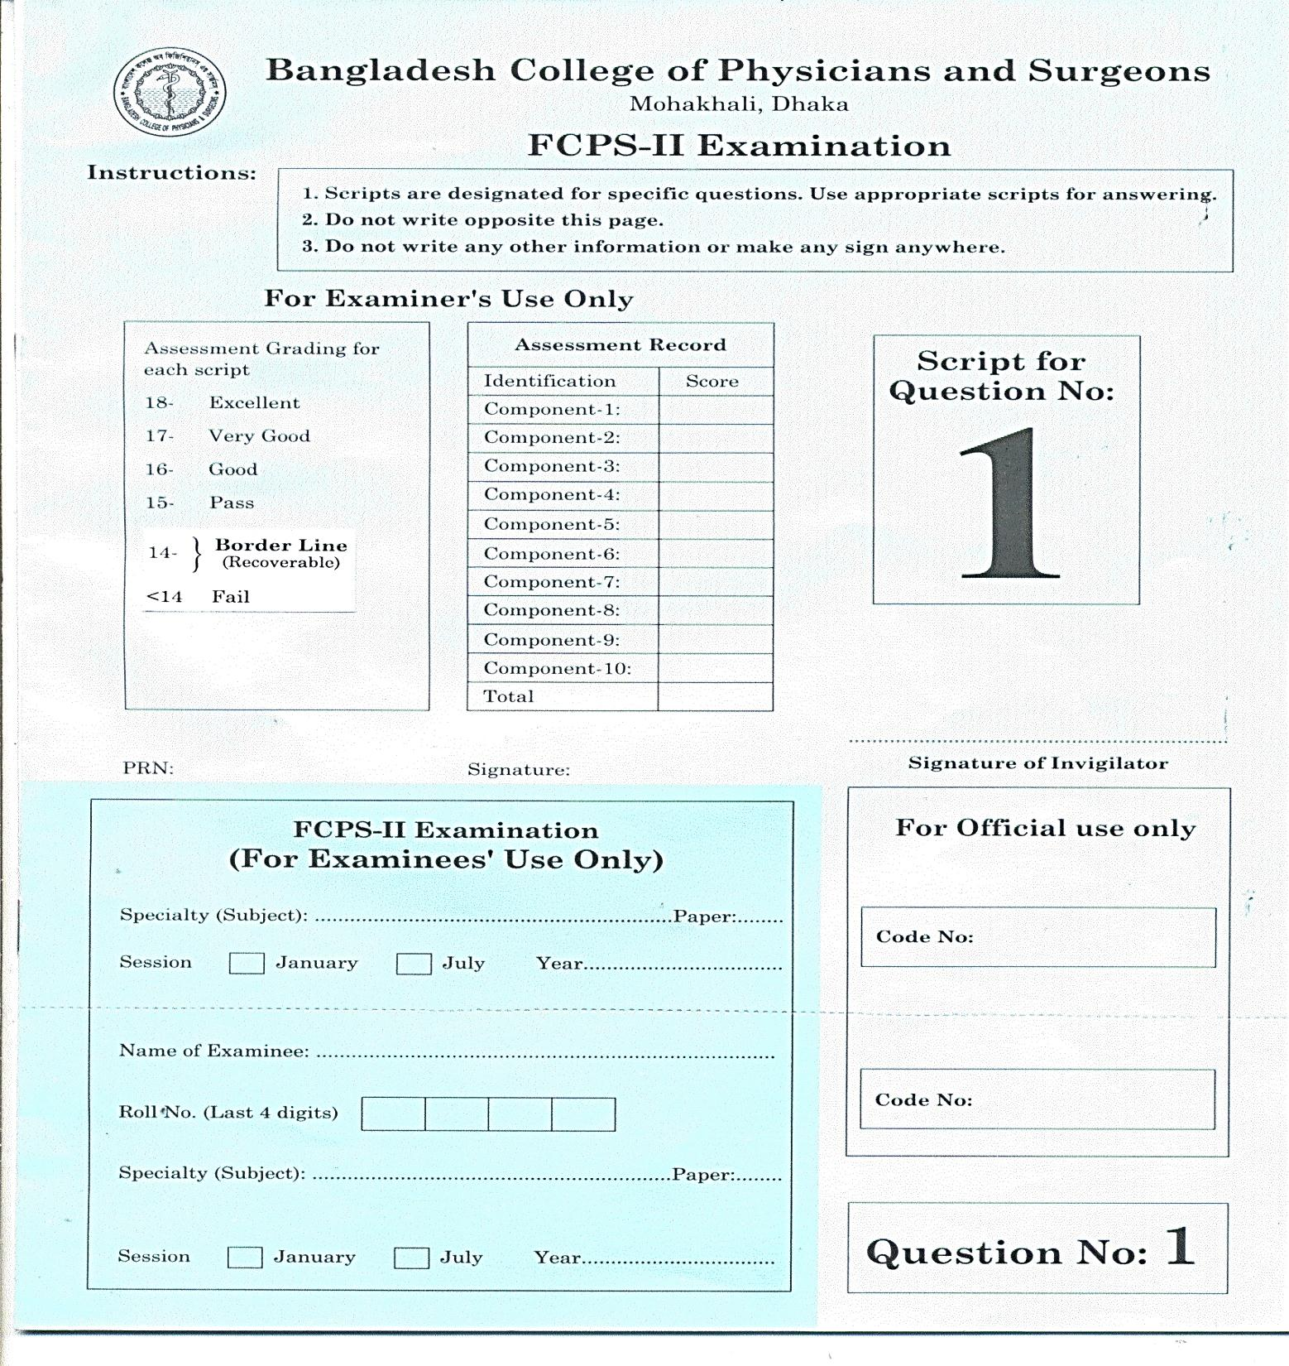

Slide 16
Regarding Written Script:
In many occasion candidates apply for reassessment of written script so please put your total marks on the top of script (component wise) and signature before posting the mark in the mark sheet.

Slide 17
Example:
Paper-I |  |  |  | Paper-II |  |  |  | Grand Total | Grade
Q1 | Q2 | Q3 | Q4 | Q1 | Q2 | Q3 | Q4
8 | 14 | 10 | 16 | 16 | 15 | 12 | 15 | 106 | 13.25
13 | 13 | 14 | 14 | 14 | 13 | 13 | 14 | 108 | 13.5
6 | 14 | 12 | 14 | 15 | 16 | 14 | 13 | 104 | 13
13 | 13 | 12 | 12 | 16 | 16 | 15 | 14 | 112 | 14
16 | 12 | 8 | 18 | 16 | 10 | 16 | 16 | 112 | 14

Slide 18
NOTE:
This change in grade is only applicable for written script assessment, not for other two compartments where 13 is still recoverable marks.
Now the students who will qualify in the written will require 29.5 total in the next two compartments (Clinical + Practical) to pass.

Slide 19
Thank You All

